Slide 1
Part 9: I/O System & Disk
I/O Hardware
I/O System Design and Implementation
  Design Objectives
  Kernel I/O Structure
  Kernel I/O Subsystem
  Performance Consideration
Disk
  Disk Structure
  Disk Scheduling
    FCFS, SSTF, SCAN, C-SCAN, C-LOOK
  Disk Management
  Disk Reliability
Notes:
Perhaps the messiest aspect of operating system design is input/output. Because there is such a wide variety of devices and applications of those devices, it is difficult to develop a general, consistent solution.
We begin this part of the lecture with a brief discussion of I/O devices. This topic, which generally comes within the scope of computer architecture, will set the stage for an examination of I/O from the point of view of the operating system.
The next section examines operating system design issues, including design objectives, and the way in which the I/O function can be structured.
The last section is devoted to magnetic disk I/O. In contemporary systems, this form of I/O is the most important and is key to the performance as perceived by the user.

Slide 2
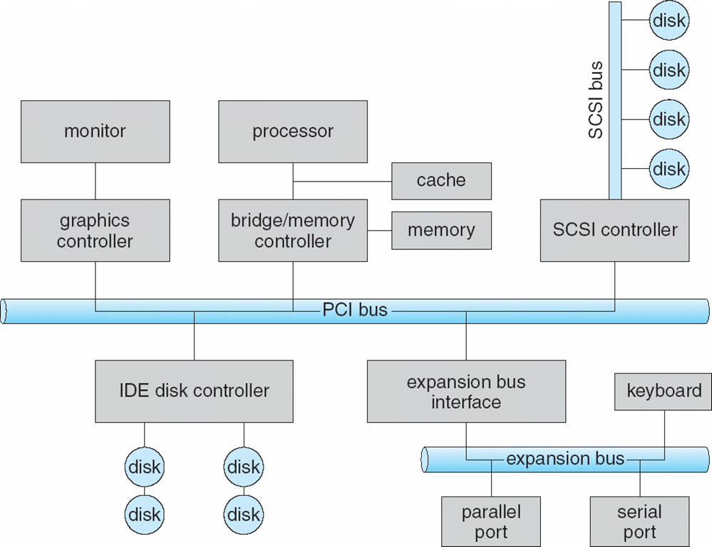
I/O Hardware
Notes:
A typical PC bus structure.
PCI Bus (The common PC system bus) connects processor-memory subsystem to fast devices
Expansion bus connects relatively slow devices
Controller operates device and is often implemented as a host adaptor
Processor communicates with controller by issuing special I/O instructions on controller’s I/O port address
(For memory mapped I/O, controller’s registers are mapped into the address space of processor. The processor executes I/O requests by directly read/write the memory-mapped region.)

Slide 3
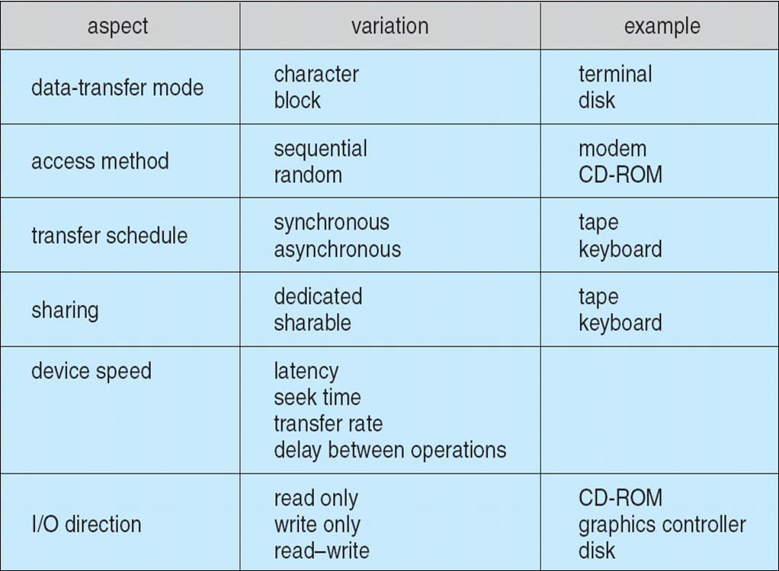
I/O Hardware
Devices vary in many dimensions
Notes:
External devices that engage in I/O with computer systems can be roughly grouped into three categories:
• Human readable: Suitable for communicating with the computer user.
Examples include printers and terminals, the latter consisting of video display, keyboard, and perhaps other devices such as a mouse.
Machine readable: Suitable for communicating with electronic equipment.
Examples are disk drives, USB keys, sensors, controllers, and actuators.
• Communication: Suitable for communicating with remote devices. Examples
are digital line drivers and modems.

Slide 4
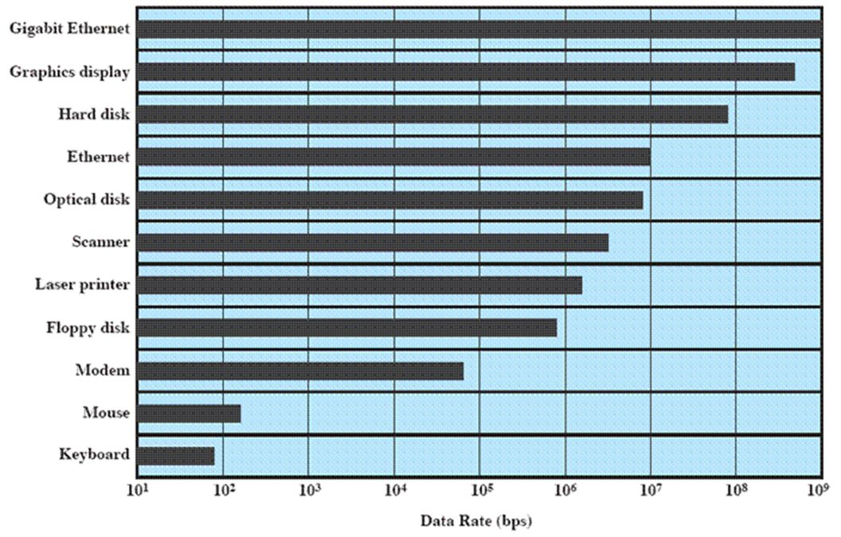
I/O Hardware
Notes:
Data rate of various I/O devices
There may be differences of several orders of magnitude between the data transfer rates.

Slide 5
I/O System Design Objectives
Efficiency
  Important because I/O operations often form a bottleneck
  Most I/O devices are extremely slow compared with main memory and the processor
  The area that has received the most attention is disk I/O
Generality
  Desirable to handle all devices in a uniform manner
  Applies to the way processes view I/O devices and the way the operating system manages I/O devices and operations
Notes:
Two objectives are paramount in designing the I/O facility: efficiency and generality.
Efficiency is important because I/O operations often form a bottleneck in a computing system. As shown the last slide, we see that most I/O devices are extremely slow compared with main memory and the processor. One way to tackle this problem is multiprogramming, which, as we have seen, allows some processes to be waiting on I/O operations while another process is executing. However, even with the vast size of main memory in today’s machines, it will still often be the case that I/O is not keeping up with the activities of the processor. Thus, a major effort in I/O design has been schemes for improving the efficiency of the I/O. The area that has received the most attention, because of its importance, is disk I/O.
The other major objective is generality . In the interests of simplicity and freedom from error, it is desirable to handle all devices in a uniform manner. This statement applies both to the way in which processes view I/O devices and the way in which the operating system manages I/O devices and operations. Because of the diversity of device characteristics, it is difficult in practice to achieve true generality. What can be done is to use a hierarchical, modular approach to the design of the I/O system. This approach hides most of the details of device I/O in lower level routines so that user processes and upper levels of the operating system see devices in terms of general functions, such as read, write, open, close, lock, and unlock.

Slide 6
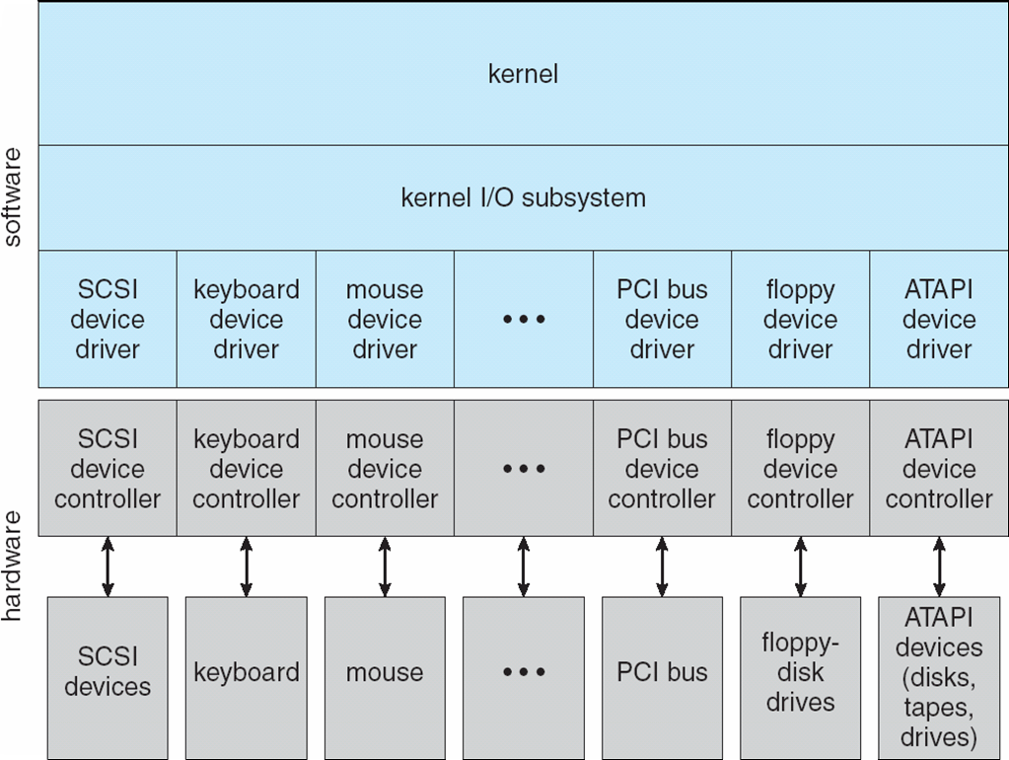
Kernel I/O Structure
Notes:
To achieve generality,
I/O system calls encapsulate device behaviours in generic classes and provide an application I/O interface
Kernel I/O subsystem provides generic services
Device-driver layer hides differences among I/O controllers from kernel
Add new I/O device doesn’t need to change I/O interface and kernel I/O subsystem

Slide 7
Kernel I/O Subsystem
I/O Scheduling
  Schedule I/O request through rearranging the order of service, e.g. disk scheduling
  Can improve the system efficiency
Buffering
  Store data in memory while transferring between devices
  To cope with device speed mismatch
  To cope with device transfer size mismatch, e.g. in networking

Slide 8
Kernel I/O Subsystem
Caching
  Fast memory holding copy of data
  To improve I/O efficiency for files that are being written and reread rapidly.
Spooling
  Hold output for a device
  Used in device that can serve only one request at a time, e.g. printing

Slide 9
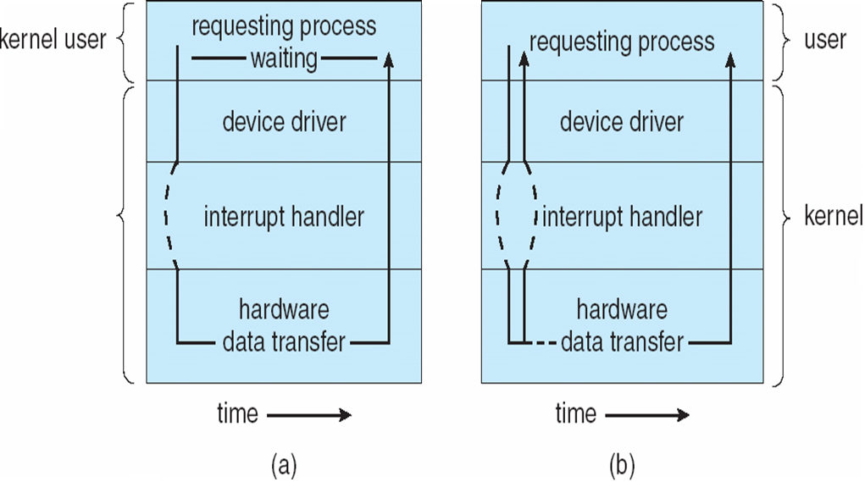
Performance Consideration
Two I/O Methods
Synchronous / Blocking I/O
Asynchronous / Non-blocking I/O
Notes:
For blocking I/O, process suspended until I/O completed
For non-blocking I/O, process runs while I/O executes. I/O subsystem signals process when I/O completed
Generally, blocking I/O is appropriate when the process will only be waiting for one specific event. Examples include a disk, tape, or keyboard read by an application program. Non-blocking I/O is useful when I/O may come from more than one source and the order of the I/O arrival is not predetermined. Examples include network daemons listening to more than one network socket, window managers that accept mouse movement as well as keyboard input, and I/O-management programs, such as a copy command that copies data between I/O devices. In the last case, the program could optimize its performance by buffering the input and output and using non-blocking I/O to keep both devices fully occupied.

Slide 10
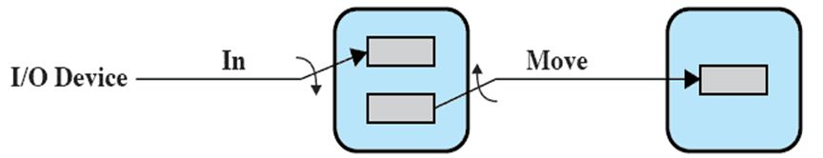
Performance Consideration
Using asynchronous I/O and double-buffer to improve performance
Double
Buffer
User
Process

Slide 11
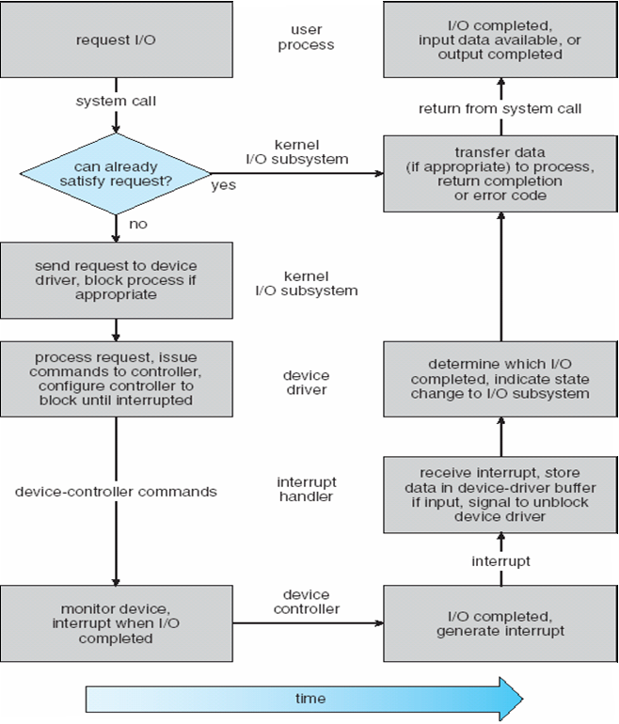
Performance Consideration
Notes:
Consider reading a data block of a file:
File system determines the device holding the file and translates logical block number to physical block number
Kernel I/O subsystem checks if the required block available in memory, if not physically reads data from disk into buffer
Make data available to requesting process
Return control to process

Slide 12
Performance Consideration
I/O is a major factor in system performance
  It demands CPU to execute device driver code
  Context switches due to interrupts may stress CPU
  Data copying between I/O controllers and physical memory also affect system performance.
Notes:
Reduce number of context switches
Reduce data copying
Reduce interrupts by using DMA (instead of interrupt driven I/O)
Balance CPU, memory, bus, and I/O performance for highest throughput

Slide 13
Part 7: I/O System & Disk
I/O Hardware
I/O System Design and Implementation
  Design Objectives
  Kernel I/O Structure
  Kernel I/O Subsystem
  Performance Consideration
Disk
  Disk Structure
  Disk Scheduling
    FCFS, SSTF, SCAN, C-SCAN, C-LOOK
  Disk Management
  Disk Reliability
Notes:
Perhaps the messiest aspect of operating system design is input/output. Because there is such a wide variety of devices and applications of those devices, it is difficult to develop a general, consistent solution.
We begin this part of the lecture with a brief discussion of I/O devices. This topic, which generally comes within the scope of computer architecture, will set the stage for an examination of I/O from the point of view of the operating system.
The next section examines operating system design issues, including design objectives, and the way in which the I/O function can be structured.
The last section is devoted to magnetic disk I/O. In contemporary systems, this form of I/O is the most important and is key to the performance as perceived by the user.

Slide 14

Disk Structure
Sectors
(1 sector = 512 bytes)
Disk heads
Platters
Notes:
Two classes of disk (IDE/SATA and SCSI)

Slide 15

Disk Structure
Disk drives are addressed as large 1-dimensional arrays of physical blocks, where the physical block is the smallest unit of transfer (usually 512 bytes)
The array of physical blocks is mapped into the sectors of the disk sequentially
Notes:
A disk is a stack of 1 or more platters
A platter can have two active surfaces
Each surface is divided into concentric tracks (imagine rings)
A track is divided into sectors
A sector (512 bytes) is a unit of disk read/write
A cylinder is a combination of tracks that are lined-up together
A disk head (or disk arm) is used to read sectors

Slide 16
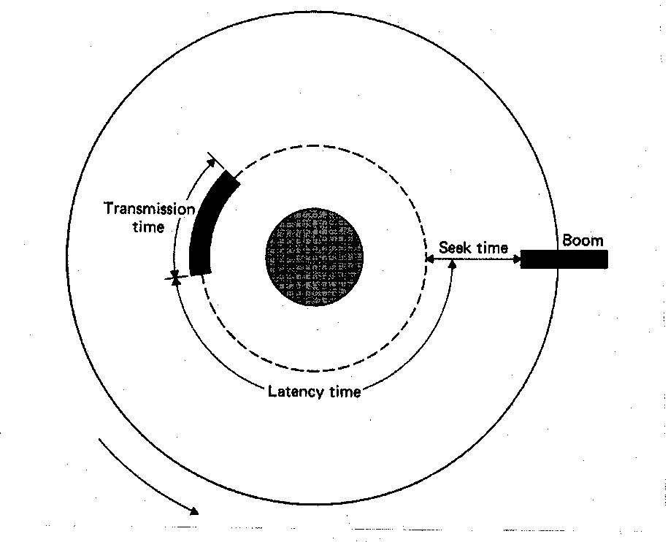
Disk Scheduling
The OS is responsible for using hardware efficiently — for disk drives this means having a fast access time and high disk bandwidth
Access time has two major components
  Seek time for the disk to move the heads to the track containing the desired sector (5 -25 milliseconds)
  Rotational latency for the disk to rotate the desired sector to the disk head (8 milliseconds)
Notes:
To read a requested sector – position the disk head + data transfer
A disk is spinning all the time – Spinning is faster than moving head from one track to another

Slide 17
Disk Scheduling (Cont.)
Minimize seek time
Seek time ≈ seek distance
Disk bandwidth is the total number of bytes transferred, divided by the total time between the 1st request and completion of the last transfer

Slide 18
Disk Scheduling (Cont.)
Several algorithms exist to schedule the servicing of disk I/O requests
We illustrate them with a request queue (0 -199)
98, 183, 37, 122, 14, 124, 65, 67
Assume that head is initially at cylinder 53

Slide 19

First-Come-First-Served (FCFS)
Notes:
The simplest form of scheduling is first-in-first-out (FIFO) scheduling, which processes items from the queue in sequential order. This strategy
has the advantage of being fair, because every request is honored and the requests are honored in the order received. Figure illustrates the disk arm movement with FIFO. As can be seen, the disk accesses are in the same order as the requests were originally received.
With FIFO, if there are only a few processes that require access and if many of the requests are to clustered file sectors, then we can hope for good performance. However, this technique will often approximate random scheduling in performance, if there are many processes competing for the disk. Thus, it may be profitable to consider a more sophisticated scheduling policy.

Slide 20
FCFS (Cont.)
Total head movement =
|98 - 53| + |183 - 98| + |37 - 183| + |122 - 37| +
|14 -122| + |124 -14| + |65 -124| + |67 - 65|
= 640
Problem: FCFS may have wild swings back and forth!

Slide 21
Shortest-Seek-Time-First (SSTF)
Selects the request with the minimum seek time from the current head position
SSTF scheduling is a form of SJF scheduling; may have starvation under heavy load, since distant requests may never be serviced
Note: requests are from processes executing concurrently
Notes:
The shortest-service-time-first (SSTF) policy is to select the disk I/O request that requires the least movement of the disk arm from its current position. Thus, we always choose to incur the minimum seek time. Of course, always choosing the minimum seek time does not guarantee that the
average seek time over a number of arm movements will be minimum. However, this should provide better performance than FIFO. A random tie-breaking algorithm may be used to resolve cases of equal distances.

Slide 22

SSTF (Cont.)

Slide 23
SSTF (Cont.)
Total head movement =
|65 - 53| + |67 - 65| + |37 - 67| + |14 - 37| +
|98 -14| + |122 - 98| + |124 - 122| + |183 - 124|
= 236
Problem: SSTF may cause starvation!

Slide 24
SCAN
Disk arm starts at one end of the disk, and moves toward the other end, servicing requests until it gets to the other end of the disk, where the head movement is reversed and servicing continues
Also called the elevator algorithm
Assuming here the head is moving toward 0
Starvation unlikely but servicing requests may be delayed
Notes:
Different from FIFO, in SSTF there may always be new requests arriving that will be chosen before an existing request. A simple alternative that prevents this sort of starvation is the SCAN algorithm, also known as the elevator algorithm because it operates much the way an elevator does.
With SCAN, the arm is required to move in one direction only, satisfying all outstanding requests en route, until it reaches the last track in that direction or until there are no more requests in that direction. This latter refinement is sometimes referred to as the LOOK policy. The service direction is then reversed and the scan proceeds in the opposite direction, again picking up all requests in order.
Note that the SCAN policy is biased against the area most recently traversed. Thus it does not exploit locality as well as SSTF.

Slide 25
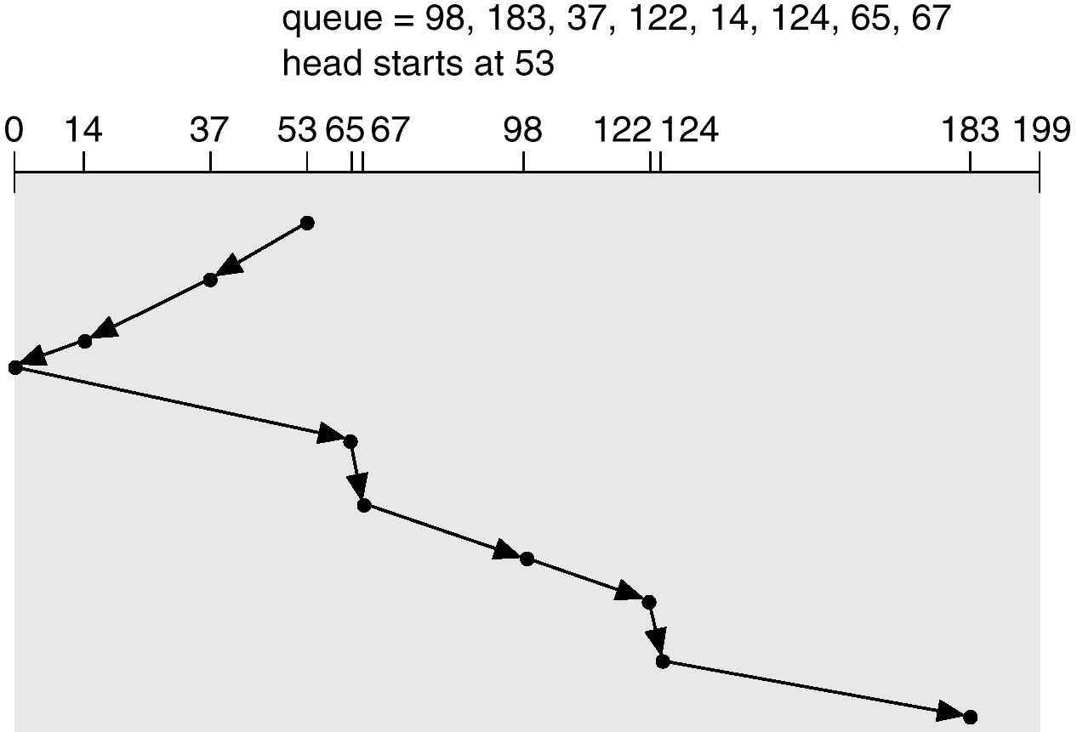
SCAN (Cont.)

Slide 26
SCAN (Cont.)
Total head movement =
|37 - 53| + |14 - 37| + |0 - 14| + |65 - 0| + |67 - 65|
+ |98 - 67| + |122 - 98| + |124 - 122| + |183 - 124|
= 236
After the head reverses direction, does it needs to serve requests in the reversed direction immediately?

Slide 27
Circular-Scan (C-SCAN)
Head moves from low end to high end of the disk, servicing requests along
When reaching the high end, head immediately returns to the beginning of the disk, without servicing any requests
Notes:
The C-SCAN (circular SCAN) policy restricts scanning to one direction only. Thus, when the last track has been visited in one direction, the arm is returned to the opposite end of the disk and the scan begins again. This reduces the maximum delay experienced by new requests. With SCAN, if the expected time for a scan from inner track to outer track is t , then the expected service interval for sectors at the periphery is 2 t. With C-SCAN, the interval is on the order of t + s max , where s max is the maximum seek time.

Slide 28

C-SCAN (Cont.)

Slide 29
C-SCAN (Cont.)
Total head movement =
|65 - 53| + |67 - 65| + |98 - 67| + |122 - 98| +
|124 - 122| + |183 -124| + |199 - 183| +
|0 -199| + |14 - 0| + |37 -14|
= 382

Slide 30
C-LOOK
Version of C-SCAN
Head moves from low end to high end of the disk, servicing requests along
When reaching the last request, head returns immediately to the lowest cylinder # request
From there it services the requests towards the high end of the disk

Slide 31

C-LOOK (Cont.)

Slide 32
C-LOOK (Cont.)
Total head movement =
|65 - 53| + |67 - 65| + |98 - 67| + |122 - 98| +
|124 -122| + |183 -124| + |14 -183| + |37 - 14|
= 322
Does SCAN, C-SCAN and C-LOOK really solve the starvation problem?

Slide 33
Selecting a Disk-Scheduling Algorithm
SSTF is common and has a natural appeal
SCAN and C-SCAN (or LOOK and C-LOOK) perform better for systems that place a heavy load on the disk (since starvation is unlikely)
Performance depends on the number and types of requests

Slide 34
Selecting a Disk-Scheduling Algorithm (Cont.)
Requests for disk service can be influenced by the file-allocation method:
  A program reading a contiguously allocated file will generate requests that are close together
  A linked or indexed file, may generate requests that are widely apart, resulting in greater head movement

Slide 35
Selecting a Disk-Scheduling Algorithm (Cont.)
The disk-scheduling algorithm should be written as a separate module of the OS, allowing it to be replaced with a different algorithm if necessary
Either SSTF or C-LOOK is a reasonable choice for the default algorithm

Slide 36
Disk Management
Low-level formatting (physical formatting) — Dividing a disk into sectors that the disk controller can read and write
To use a disk to hold files, the OS needs to record its own data structures on the disk. Two steps:
  Partition the disk into one or more groups of cylinders
  Logical formatting or “making a file system”

Slide 37
Disk Management (Cont.)
Bootstrap program initializes system (i.e., starts computer)
  A tiny bootstrap is stored in ROM, which loads the full bootstrap program (stored at disk boot blocks) into memory, and starts executing it
  Finds the OS kernel on disk and loads it into memory
  Then jumps to an initial address to start OS
Notes:
In Windows 2000, the boot code is placed in the first sector on the hard disk (which is called MBR – Master Boot Record). The hard disk is divided into multiple partitions. One of the partitions is identified as boot partition, contains the operating system code and device drivers.

Slide 38
Disk Reliability
Several improvements in disk-use techniques involve multiple disks working cooperatively
Disk striping uses a group of disks as one storage unit
  Each block is broken into several sub-blocks, with one sub-block stored on each disk
  Time to transfer a block into memory is faster because all sub-blocks are transferred in parallel

Slide 39
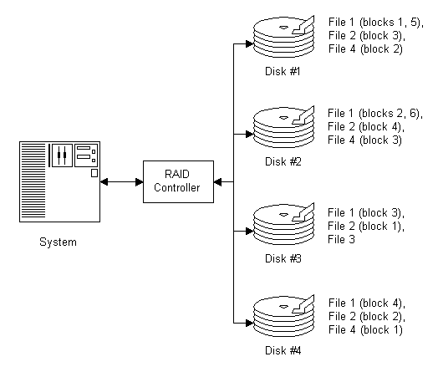
Disk Reliability (cont.)

Slide 40
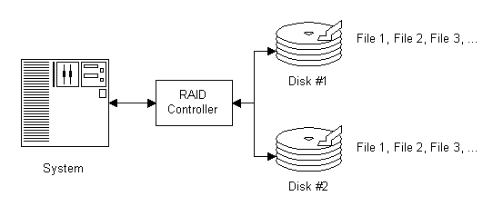
Disk Reliability (cont.)
Mirroring keeps duplicate of each disk
  A logical disk consists of two physical disks
  If one fails, the data can be read from the other

Slide 41
Disk Reliability (cont.)
RAID (Redundant-Array-of-Independent-Disks) improves performance and reliability of the storage system by storing redundant data
  RAID 0: non-redundant striping
  Mirroring (RAID 1) keeps duplicate of each disk
  Mirror of Strips (RAID 0+1) or Strips of Mirrors (RAID 1+0) provides high performance and high reliability
Notes:
With the use of multiple disks, there is a wide variety of ways in which the data can be organized and in which redundancy can be added to improve reliability. This could make it difficult to develop database schemes that are usable on a number of platforms and operating systems. Fortunately, industry has agreed on a standardized scheme for multiple-disk database design, known as RAID (redundant array of independent disks). The RAID scheme consists of seven levels, zero through six.

Slide 42
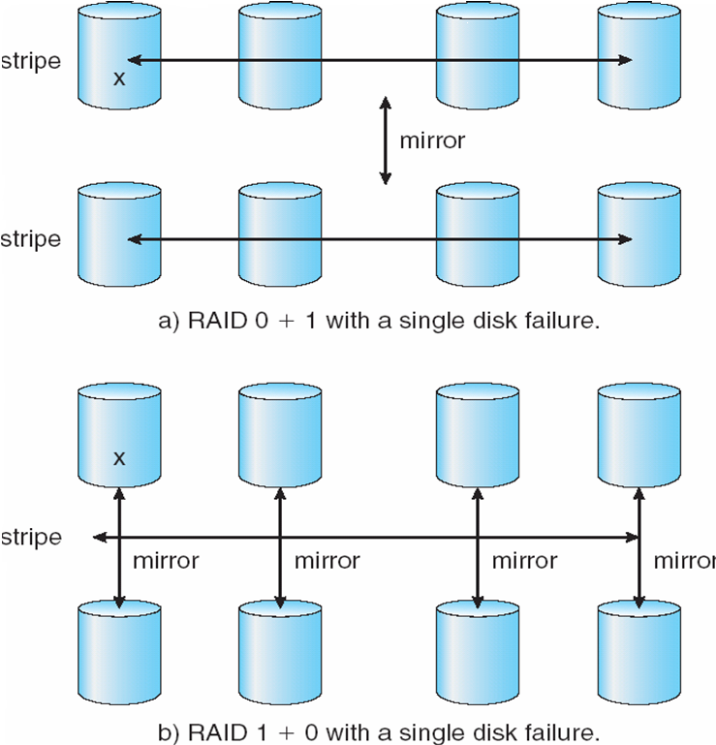
Disk Reliability (cont.)
Notes:
1+0 has better reliability than 0+1

Slide 43
Summary
Device-driver layer hides the differences among device controllers from the I/O subsystem of the kernel.
The I/O subsystem provides functions for: I/O scheduling, buffering, spooling, error handling, device reservation, and device name translation.
I/O system calls are costly in terms of CPU consumption, because of the many layers of software between a physical device and the application.

Slide 44
Summary
Disk scheduling algorithms optimize seek time:
  FCFS, SSTF, SCAN, C-SCAN, C-LOOK
Disk management requires disk partitioning and formatting
Disk striping improve performance
Mirroring improves reliability

